Slide 1
Test Smells
Prepared By
Popy Das

Slide 2
Contents
Introduction
Types of Test Smells
Fine-tuning CodeBart for a Dataset

Slide 3
Introduction
Test smells are poorly designed tests.
Their presence may negatively affect the quality of test suites and production code.
Test smells are analogous to code smells in application code.
The importance of identifying and addressing test smells are early detection of issues, quality assurance, cost savings and so on

Slide 4
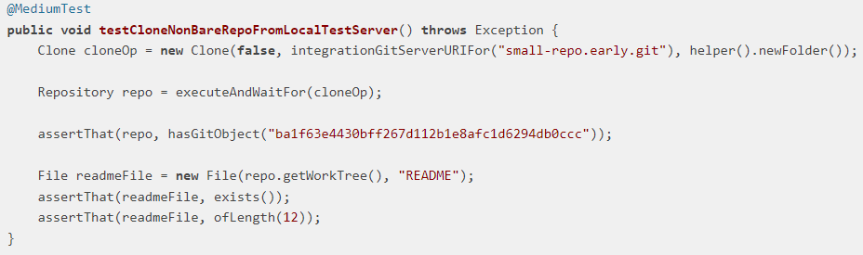
Types of Test Smells
Assertion Roulette
A test case with numerous assertions for various functionalities or steps.
Lack of descriptive assertion messages, leaving on guessing which one triggered the failure.
Difficulty isolating the failing assertion, leading to longer debugging times.
Detection: A test method contains more than one assertion statement without an explanation/message.
Figure 1: Assertion Roulette test smell example

Slide 5
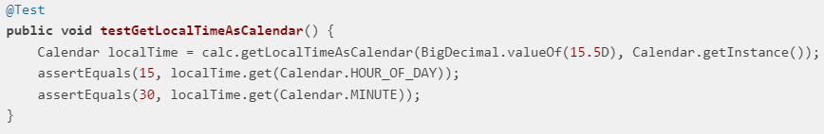
Magic Number Test
Hardcoding specific numerical values directly within test code without any explicit explanation of their meaning or purpose.
It's like using a secret code without providing the key, making the code less readable, maintainable, and adaptable to changes.
Detection: An assertion method that contains a numeric literal as an argument.
Figure 2: Magic number test smell example

Slide 6
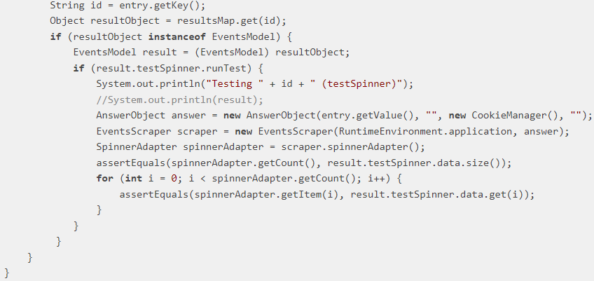
Conditional Logic Test
Test method incorporates conditional statements or loops within its logic, controlling the execution flow and assertions.
While conditional logic can be necessary, excessive use within tests can hinder readability, maintainability, and reliability.
Detection: A test method that contains one or more control statements.
Figure 3: Magic number test smell example

Slide 7
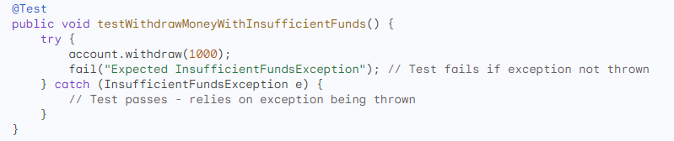
Exception Handling Test
Contain try-catch blocks where the catch block asserts or fails the test.
Throw exceptions explicitly to manipulate the test outcome.
Detection: A test method that contains either a throw statement or a catch clause.
Figure 4: Exception handling test smell example

Slide 8
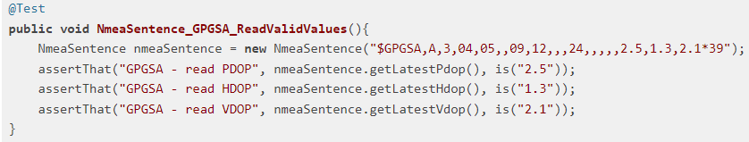
Eager Test
Occurs when a test method invokes several methods of the production object.
This smell results in difficulties in test comprehension and maintenance.
Detection: A test method contains multiple calls to multiple production methods.
Figure 5: Eager test smell example

Slide 9
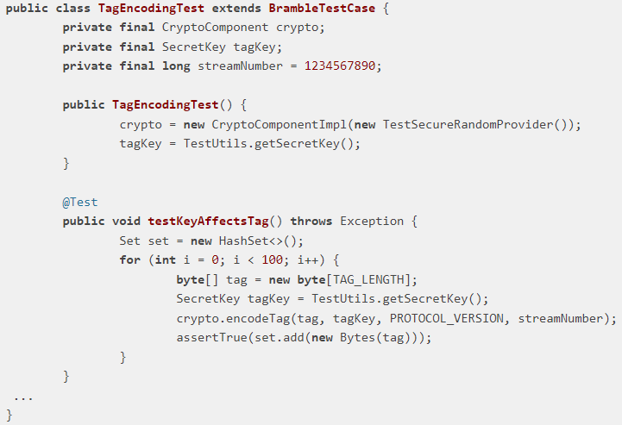
Constructor Initialization
The test suite should not have a constructor.
Initialization of fields should be in the setUp() method.
Detection: A test class that contains a constructor declaration.
Figure 6: Constructor initialization test smell example

Slide 10
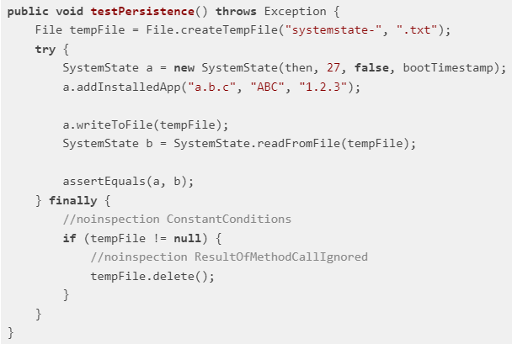
Mystery Guest
Occurs when a test method utilizes external resources.
Use of external resources in test methods will result in stability and performance issues.
Detection: A test method containing object instances of files and databases classes.
Figure 7: Mistry guest test smell example

Slide 11
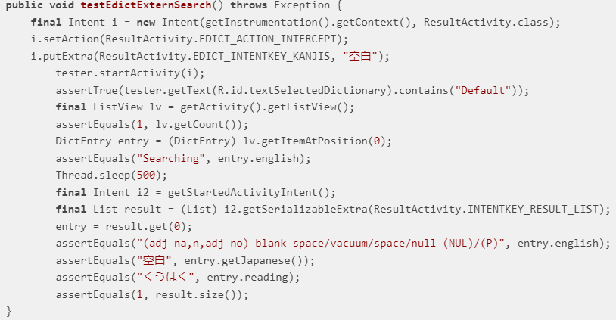
Sleepy Test
Explicitly causing a thread to sleep can lead to unexpected results as the processing time for a task can differ on different devices.
Developers introduce this smell when they need to pause execution of statements in a test method for a certain duration and then continuing with execution.
Detection: A test method that invokes the Thread.sleep() method.
Figure 8: Sleepy test smell example

Slide 12
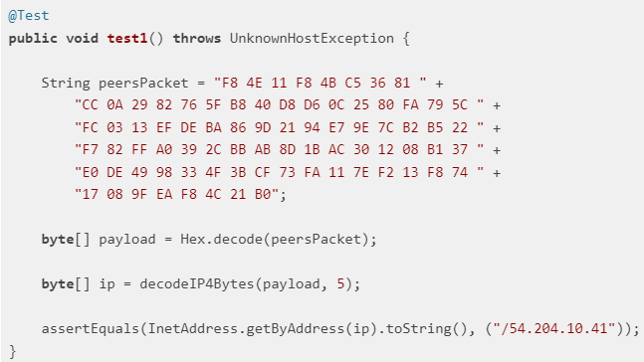
Sensitive Equality
Test methods verify objects by invoking the default toString() method of the object and comparing the output against an specific string.
Changes to the implementation of toString() might result in failure.
Detection: A test method invokes the toString() method of an object.
Figure 9: Sensitive equality test smell example

Slide 13
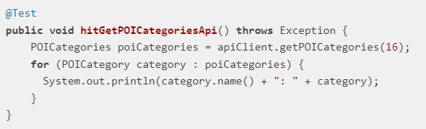
Unknown Test
Test method lacks a clear purpose or fails to verify anything significant.
Detection: A test method that does not contain a single assertion statement and @Test(expected) annotation parameter.
Figure 10: Unknown test smell example

Slide 14
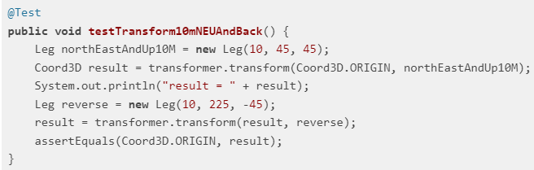
Redundant Print
Print statements in unit tests are redundant as unit tests are executed as part of an automated process with little to no human intervention.
Detection: A test method that invokes either the print or println or printf or write method of the System class.
Figure 11: Redundant print test smell example

Slide 15
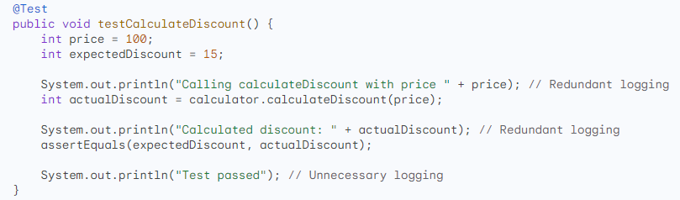
Redundant Logging
Occurs when a test logs information that is already logged elsewhere, or when the logged information provides little to no value in verifying the tested functionality.
Figure 11: Redundant logging test smell example

Slide 16
Fine-tuning CodeBart for a Dataset
1. Dataset preparation
Organize your data.
Split the dataset.
2. Model configuration
Choose hyper parameters.
Model initialization.
3. Training:
Implement loop.
Monitor on validation.
4. Optimization:
Fine-tune hyper parameters.
5. Save Model:
Save during training.
Save the final model.

Slide 17
6. Inference:
Deploy for code generation.
7. Documentation:
Document the process and insights.

Slide 18
THANK YOU

